Slide 1
Multinomial Logistic Regression

Slide 2
Step 1: Extension to Simple Logistic Regression
In simple logistic regression, we were interested in how our independent variables affect the likelihood of being either in the reference category (usually zero) or the other category (usually a 1). So for example, you might be interested in how gender and household income might influence whether or not a person bought your product (0= not purchase, 1 = purchase).
Purchase = ∞ + b₁gender + b₂income

Slide 3
Step 1: Typical Use of the Technique
Example: You want to assess variables that might affect political party membership – Democrat, Republican, Independent – using a number of variables including gender, race (white/non-white), ethnicity (Hispanic / non-Hispanic) and household income. Note that unlike logistic regression where the DV is a dichotomous (0,1) variable, here we have a nominal level DV where there are three categories – e.g. political party membership.
Party = ∞ + b₁gender + b₂race + b₃hispanic + b₄income

Slide 4
Step 1: Typical Use of the Technique
Let’s see if we can predict employment status by whether or not they watch fox news or the apprentice. Employment status is 1=unemployed, 2=employed parttime, 3=employed fulltime
Employment status = ∞ + b₁fox_news_channel + b₂the_apprentice_nbc_

Slide 5
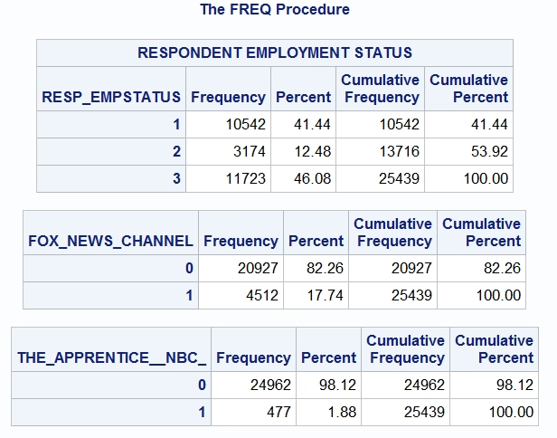
Step 2: Inspect the Data
And here are the reference categories we will use
DV= employment status
1=unemployed
2=parttime
3=fulltime
Reference category
IV#1 watch fox news
0=no
1=yes
Reference category
IV#2 watch apprentice
0=no
1=yes
Reference category
Notes:
If students will be required to write a research proposal or conduct a study as a course project, or if students have ongoing research projects such as theses or dissertations, and if the class is reasonably small, it may be useful to elicit descriptions of their research interests early in the course and use these research questions as a focus for discussion. If the class is large or students do not have well defined research interests, you may want to focus discussion on the empirical examples presented in the chapter.

Slide 6
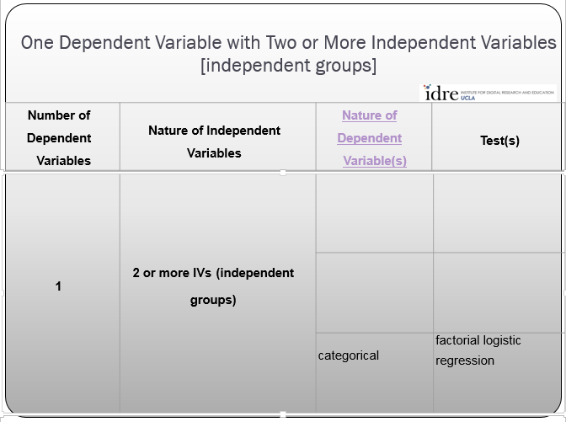
Step 3: Analysis Run
a. Determine the technique to use from idre chart
Categorical with
> 2 categories
Multinomial logistic
regression
Notes:
If students will be required to write a research proposal or conduct a study as a course project, or if students have ongoing research projects such as theses or dissertations, and if the class is reasonably small, it may be useful to elicit descriptions of their research interests early in the course and use these research questions as a focus for discussion. If the class is large or students do not have well defined research interests, you may want to focus discussion on the empirical examples presented in the chapter.

Slide 7
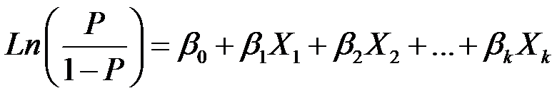
Step 3: Analysis Run
c. What makes this technique tick?
Now our DV variable is a logit that describes the likelihood of not being in the reference category just like simple logistic regression!
So we will use a statistical technique – logistic regression – that transforms the DV. We will transform the DV into something called a “logit” or “log odds ratio”. We can run this model for each of our comparisons against the reference category in the DV.
Notes:
If students will be required to write a research proposal or conduct a study as a course project, or if students have ongoing research projects such as theses or dissertations, and if the class is reasonably small, it may be useful to elicit descriptions of their research interests early in the course and use these research questions as a focus for discussion. If the class is large or students do not have well defined research interests, you may want to focus discussion on the empirical examples presented in the chapter.

Slide 8
Step 4: SAS Code
libname mylib "P:\";
data fetch;
set mylib.emba1;
proc logistic data=fetch;
class RESP_EMPSTATUS (ref=first)
fox_news_channel (ref=first)
THE_APPRENTICE__NBC_ (ref=first)/ param = ref;
model RESP_EMPSTATUS = fox_news_channel
THE_APPRENTICE__NBC_ / link=glogit lackfit;
run;
Point to directory with permanent SAS data set
Create temp SAS data set fetch
Grab permanent SAS data set emba1
Point proc logistic at data set fetch
Tell SAS each of these variables is nominal
in nature and use the first category as the reference category and parm means use dummy coding
Model the data and tell SAS via glogit that it is a multinomial model
Also give me the Hosmer Lemeshow goodness of fit statistic

Slide 9
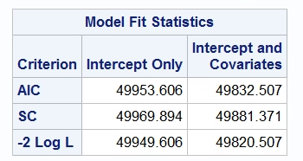
Step 5: Inspect the Output
Here are the relative goodness of fit statistics
Notes:
If students will be required to write a research proposal or conduct a study as a course project, or if students have ongoing research projects such as theses or dissertations, and if the class is reasonably small, it may be useful to elicit descriptions of their research interests early in the course and use these research questions as a focus for discussion. If the class is large or students do not have well defined research interests, you may want to focus discussion on the empirical examples presented in the chapter.

Slide 10
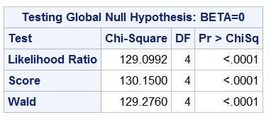
Step 5: Inspect the Output
Here is the overall test – do the IVs taken together as a model have a significant relationship with the DV. The overall test is significant!
Notes:
If students will be required to write a research proposal or conduct a study as a course project, or if students have ongoing research projects such as theses or dissertations, and if the class is reasonably small, it may be useful to elicit descriptions of their research interests early in the course and use these research questions as a focus for discussion. If the class is large or students do not have well defined research interests, you may want to focus discussion on the empirical examples presented in the chapter.

Slide 11
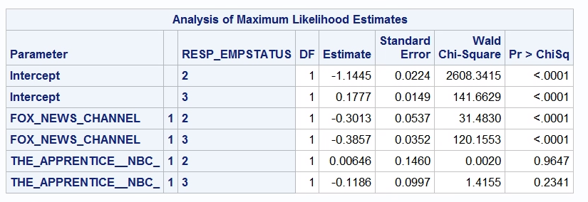
Step 5: Inspect the Output
Here are the multinomial regression parameter estimates. Here is how we interpret it one step at a time.
Those folks who watch fox news are less likely to be employed part-time than unemployed.
Notes:
If students will be required to write a research proposal or conduct a study as a course project, or if students have ongoing research projects such as theses or dissertations, and if the class is reasonably small, it may be useful to elicit descriptions of their research interests early in the course and use these research questions as a focus for discussion. If the class is large or students do not have well defined research interests, you may want to focus discussion on the empirical examples presented in the chapter.

Slide 12
Step 5: Inspect the Output
Here are the multinomial regression parameter estimates. Here is how we interpret it one step at a time.
Those folks who watch fox news are less likely to be employed fulltime than unemployed.
Notes:
If students will be required to write a research proposal or conduct a study as a course project, or if students have ongoing research projects such as theses or dissertations, and if the class is reasonably small, it may be useful to elicit descriptions of their research interests early in the course and use these research questions as a focus for discussion. If the class is large or students do not have well defined research interests, you may want to focus discussion on the empirical examples presented in the chapter.

Slide 13
Step 5: Inspect the Output
Here are the multinomial regression parameter estimates. Here is how we interpret it one step at a time.
There is no evidence of a relationship between watching the apprentice and part-time or full-time employment status.
Notes:
If students will be required to write a research proposal or conduct a study as a course project, or if students have ongoing research projects such as theses or dissertations, and if the class is reasonably small, it may be useful to elicit descriptions of their research interests early in the course and use these research questions as a focus for discussion. If the class is large or students do not have well defined research interests, you may want to focus discussion on the empirical examples presented in the chapter.

Slide 14
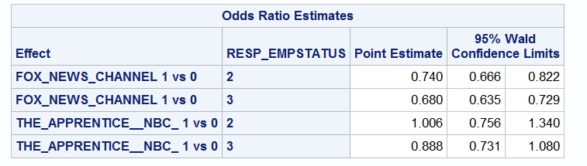
Step 5: Inspect the Output
Here are the odds ratios to put more detail into the results of the last slide…
Those folks who watch fox news are .74 times less likely to be employed part-time than unemployed.
Notes:
If students will be required to write a research proposal or conduct a study as a course project, or if students have ongoing research projects such as theses or dissertations, and if the class is reasonably small, it may be useful to elicit descriptions of their research interests early in the course and use these research questions as a focus for discussion. If the class is large or students do not have well defined research interests, you may want to focus discussion on the empirical examples presented in the chapter.

Slide 15
Step 5: Inspect the Output
Here are the odds ratios to put more detail into the results of the last slide…
Those folks who watch fox news are .68 times less likely to be employed fulltime than unemployed.
Notes:
If students will be required to write a research proposal or conduct a study as a course project, or if students have ongoing research projects such as theses or dissertations, and if the class is reasonably small, it may be useful to elicit descriptions of their research interests early in the course and use these research questions as a focus for discussion. If the class is large or students do not have well defined research interests, you may want to focus discussion on the empirical examples presented in the chapter.

Slide 16
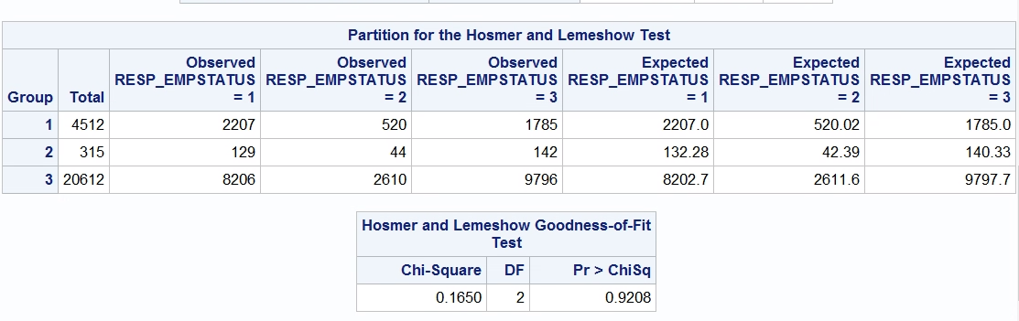
Step 5: Inspect the Output
Here is the Hosmer and Lemeshow test.
Hnull = observed and predicted counts not different from each other
Halt = observed and predicted counts are different from each other
Here we see that p>.05, so the fit is acceptable…
There are some issues of low power to detect differences but it’s still used
Notes:
If students will be required to write a research proposal or conduct a study as a course project, or if students have ongoing research projects such as theses or dissertations, and if the class is reasonably small, it may be useful to elicit descriptions of their research interests early in the course and use these research questions as a focus for discussion. If the class is large or students do not have well defined research interests, you may want to focus discussion on the empirical examples presented in the chapter.

Slide 17
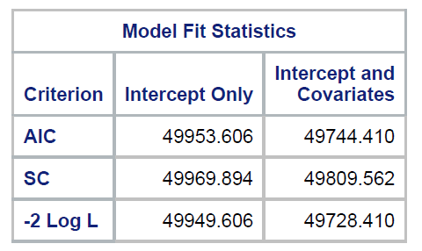
Step 5: Inspect the Output
Let’s add another variable to our model!
Let’s add whether or not we watched ESPN_NEWS in the last 7 days – here is our new model!
Original Model
New Model
Notice that our AIC has gone down in the new model!
Notes:
If students will be required to write a research proposal or conduct a study as a course project, or if students have ongoing research projects such as theses or dissertations, and if the class is reasonably small, it may be useful to elicit descriptions of their research interests early in the course and use these research questions as a focus for discussion. If the class is large or students do not have well defined research interests, you may want to focus discussion on the empirical examples presented in the chapter.

Slide 18
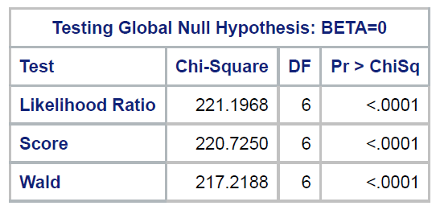
Step 5: Inspect the Output
Added ESPN_NEWS to model
Here is the overall test – do the IVs taken together as a model have a significant relationship with the DV. The overall test is significant!
Notes:
If students will be required to write a research proposal or conduct a study as a course project, or if students have ongoing research projects such as theses or dissertations, and if the class is reasonably small, it may be useful to elicit descriptions of their research interests early in the course and use these research questions as a focus for discussion. If the class is large or students do not have well defined research interests, you may want to focus discussion on the empirical examples presented in the chapter.

Slide 19
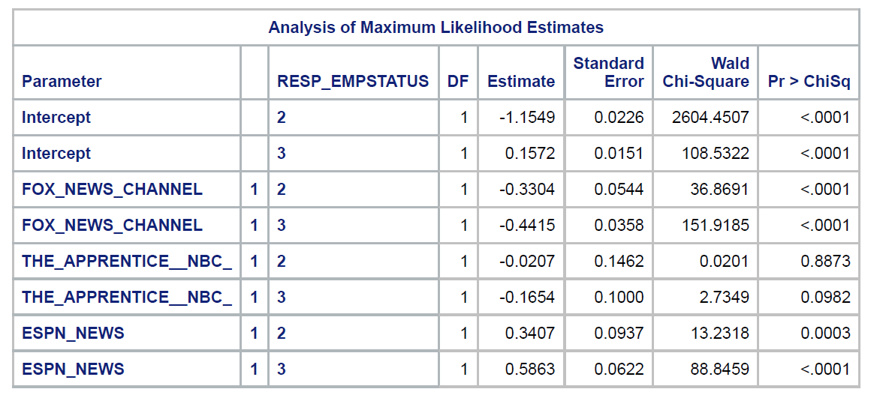
Step 5: Inspect the Output
Added ESPN_NEWS to model
The same fox news variables are still significant!
And our added ESPN_NEWS variables are significant too!
Notice the sign of the ESPN estimate!
Notes:
If students will be required to write a research proposal or conduct a study as a course project, or if students have ongoing research projects such as theses or dissertations, and if the class is reasonably small, it may be useful to elicit descriptions of their research interests early in the course and use these research questions as a focus for discussion. If the class is large or students do not have well defined research interests, you may want to focus discussion on the empirical examples presented in the chapter.

Slide 20
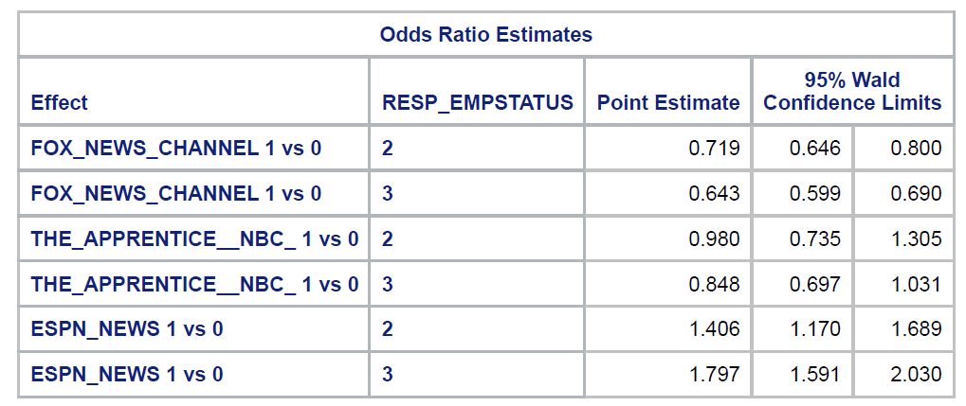
Step 5: Inspect the Output
Note that the odds ratios for fox news have not shifted much
But look at the odds ratios for ESPN – they are much more dramatic!
Old Odds Ratios
New Odds Ratios
Notes:
If students will be required to write a research proposal or conduct a study as a course project, or if students have ongoing research projects such as theses or dissertations, and if the class is reasonably small, it may be useful to elicit descriptions of their research interests early in the course and use these research questions as a focus for discussion. If the class is large or students do not have well defined research interests, you may want to focus discussion on the empirical examples presented in the chapter.

Slide 21
Step 5: Inspect the Output
Folks who watch ESPN_NEWS are 1.4 times more likely to be employed part-time than unemployed.
Old Odds Ratios
New Odds Ratios
Notes:
If students will be required to write a research proposal or conduct a study as a course project, or if students have ongoing research projects such as theses or dissertations, and if the class is reasonably small, it may be useful to elicit descriptions of their research interests early in the course and use these research questions as a focus for discussion. If the class is large or students do not have well defined research interests, you may want to focus discussion on the empirical examples presented in the chapter.

Slide 22
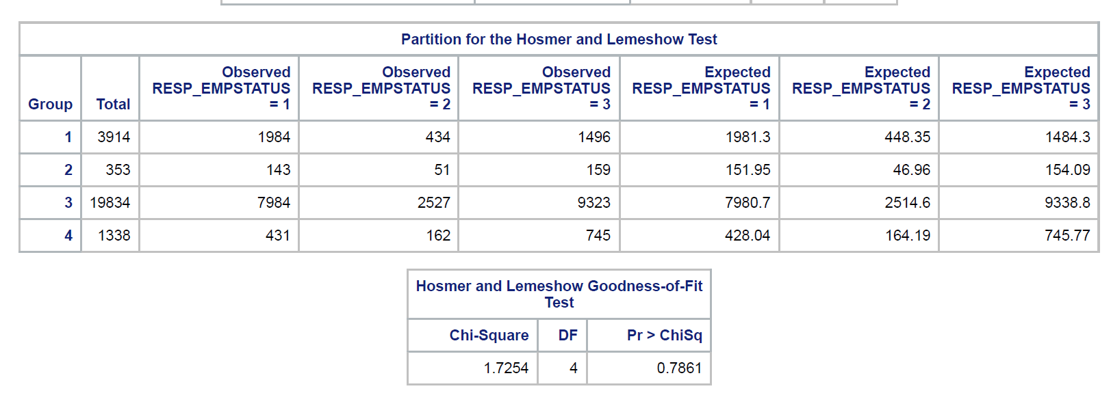
Step 5: Inspect the Output
Here is the Hosmer and Lemeshow test.
Hnull = observed and predicted counts not different from each other
Halt = observed and predicted counts are different from each other
Here we see that p>.05, so the fit is still acceptable…
There are some issues of low power to detect differences but it’s still used
Notes:
If students will be required to write a research proposal or conduct a study as a course project, or if students have ongoing research projects such as theses or dissertations, and if the class is reasonably small, it may be useful to elicit descriptions of their research interests early in the course and use these research questions as a focus for discussion. If the class is large or students do not have well defined research interests, you may want to focus discussion on the empirical examples presented in the chapter.

Slide 23
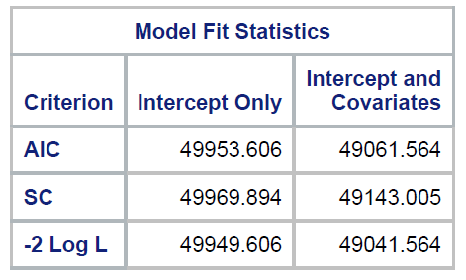
Step 5: Inspect the Output
Let’s add respondent education to our model!
Let’s see what resp_educ does to the model!
Original Model
Plus ESPN
Plus ESPN & Educ
Notice that our AIC has gone down in the new model!
Notes:
If students will be required to write a research proposal or conduct a study as a course project, or if students have ongoing research projects such as theses or dissertations, and if the class is reasonably small, it may be useful to elicit descriptions of their research interests early in the course and use these research questions as a focus for discussion. If the class is large or students do not have well defined research interests, you may want to focus discussion on the empirical examples presented in the chapter.

Slide 24
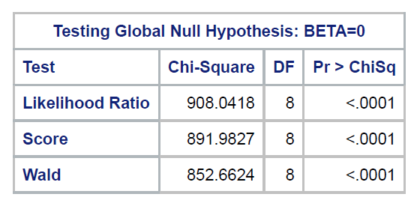
Step 5: Inspect the Output
Let’s add respondent education to our model
Here is the overall test – do the IVs taken together as a model have a significant relationship with the DV. The overall test is significant!
Notes:
If students will be required to write a research proposal or conduct a study as a course project, or if students have ongoing research projects such as theses or dissertations, and if the class is reasonably small, it may be useful to elicit descriptions of their research interests early in the course and use these research questions as a focus for discussion. If the class is large or students do not have well defined research interests, you may want to focus discussion on the empirical examples presented in the chapter.

Slide 25
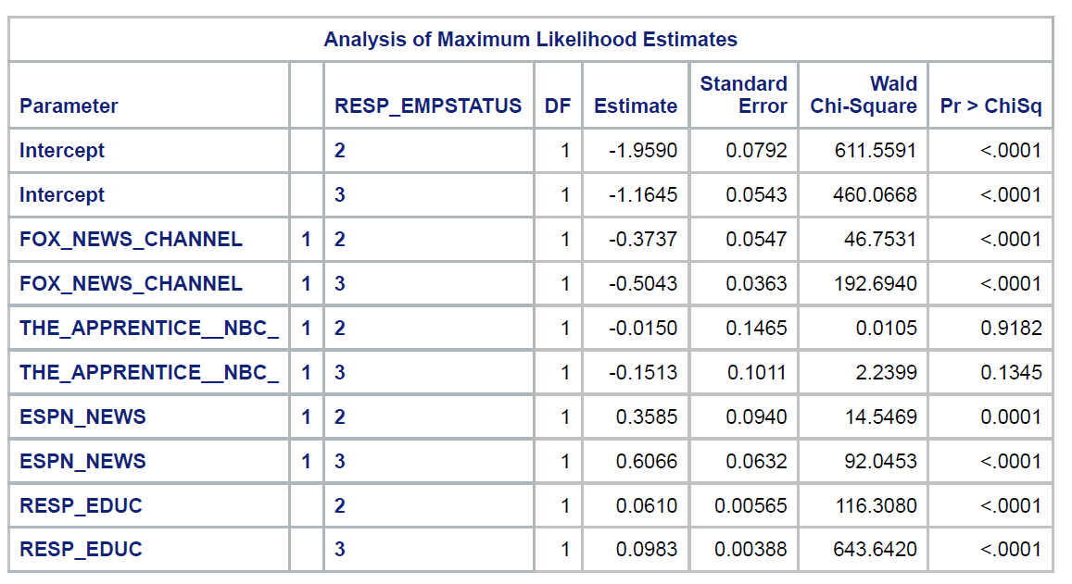
Step 5: Inspect the Output
Let’s add respondent education to our model
The same fox news variables are still significant! And our added education variable is significant too!
Notice the sign of the education estimate!
Notes:
If students will be required to write a research proposal or conduct a study as a course project, or if students have ongoing research projects such as theses or dissertations, and if the class is reasonably small, it may be useful to elicit descriptions of their research interests early in the course and use these research questions as a focus for discussion. If the class is large or students do not have well defined research interests, you may want to focus discussion on the empirical examples presented in the chapter.

Slide 26
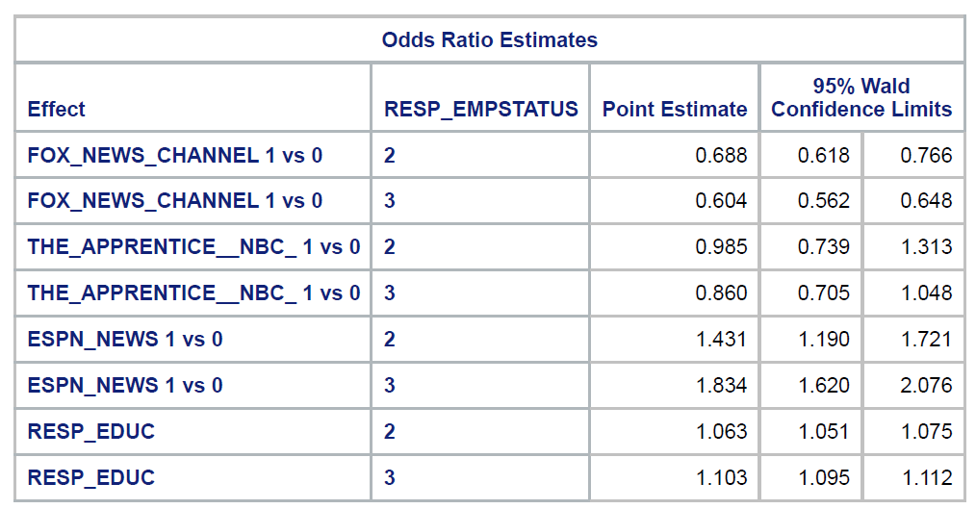
Step 5: Inspect the Output
Let’s add respondent education to our model
Original Model Odds Ratios
Plus ESPN Odds Ratios
Plus ESPN and Education
Notes:
If students will be required to write a research proposal or conduct a study as a course project, or if students have ongoing research projects such as theses or dissertations, and if the class is reasonably small, it may be useful to elicit descriptions of their research interests early in the course and use these research questions as a focus for discussion. If the class is large or students do not have well defined research interests, you may want to focus discussion on the empirical examples presented in the chapter.

Slide 27
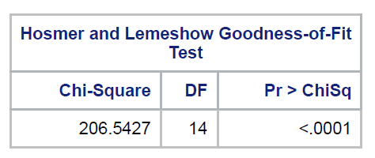
Step 5: Inspect the Output
Here is the Hosmer and Lemeshow test.
Hnull = observed and predicted counts not different from each other
Halt = observed and predicted counts are different from each other
Rhut Rho! Look at the p value for the Hosmer and Lemeshow test. Adding education has made it turn significant – suggesting that the fit of the model may not be so good. Time for some investigation!
Notes:
If students will be required to write a research proposal or conduct a study as a course project, or if students have ongoing research projects such as theses or dissertations, and if the class is reasonably small, it may be useful to elicit descriptions of their research interests early in the course and use these research questions as a focus for discussion. If the class is large or students do not have well defined research interests, you may want to focus discussion on the empirical examples presented in the chapter.

Slide 28
Step 7: Assumptions of the test
Independence of observations.
Categories of the outcome variable must be mutually exclusive and exhaustive.
No multicollinearity between independent variables.
Linear relationship between continuous variables and the logit transformation of the outcome variable.
No outliers or highly influential points.
Notes:
If students will be required to write a research proposal or conduct a study as a course project, or if students have ongoing research projects such as theses or dissertations, and if the class is reasonably small, it may be useful to elicit descriptions of their research interests early in the course and use these research questions as a focus for discussion. If the class is large or students do not have well defined research interests, you may want to focus discussion on the empirical examples presented in the chapter.

